Slide 1
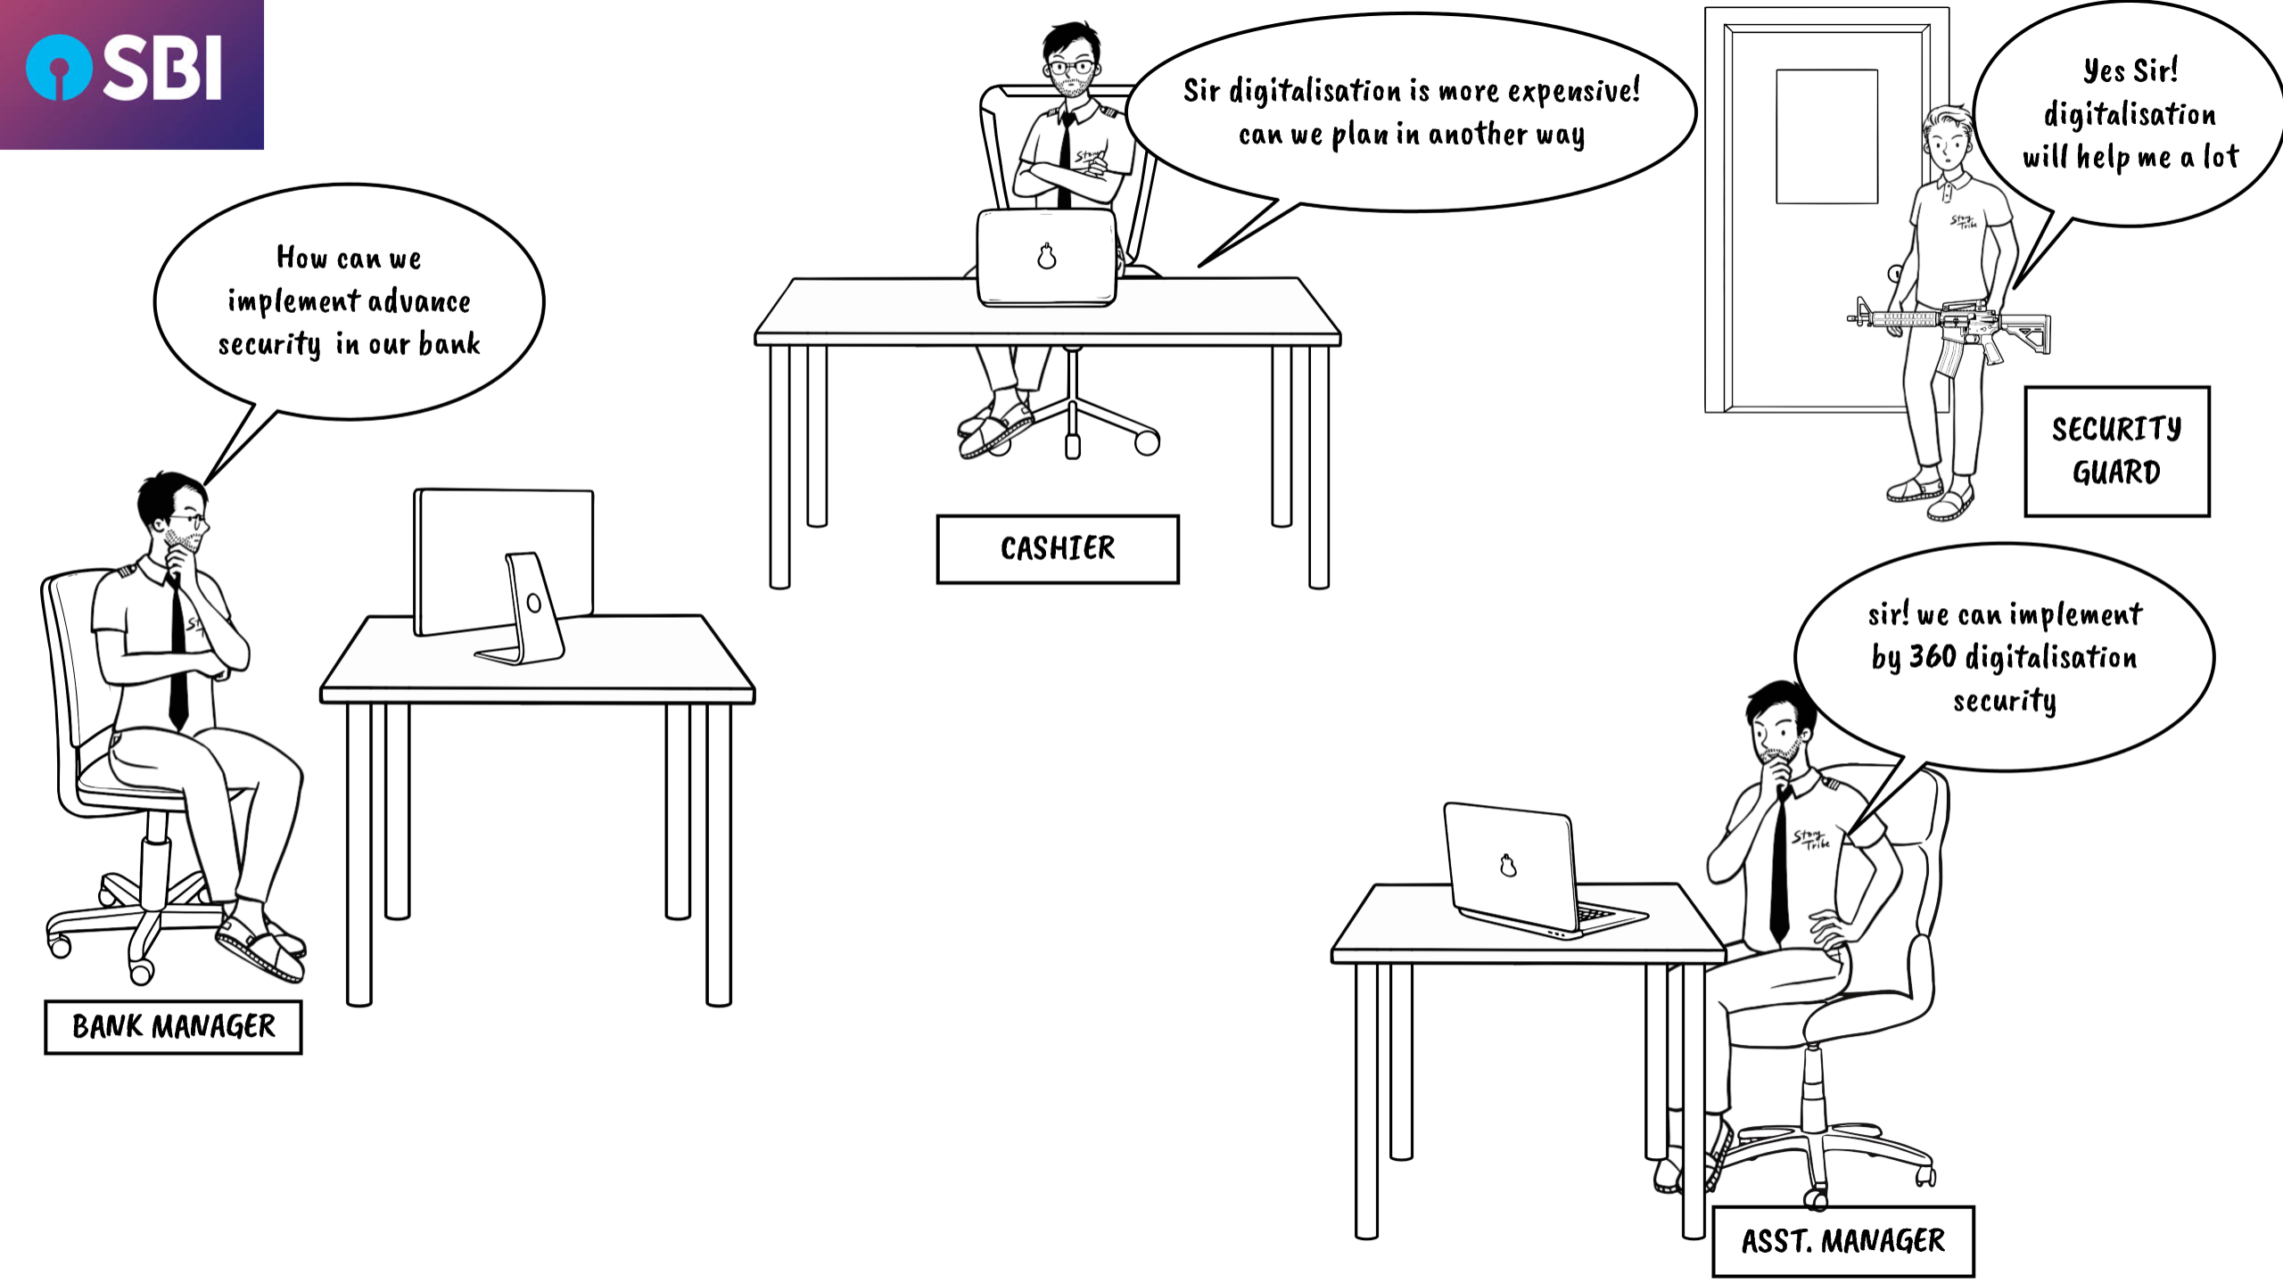
360 DEGREE DIGITALIZATION OF BANK SERVICE

Slide 2
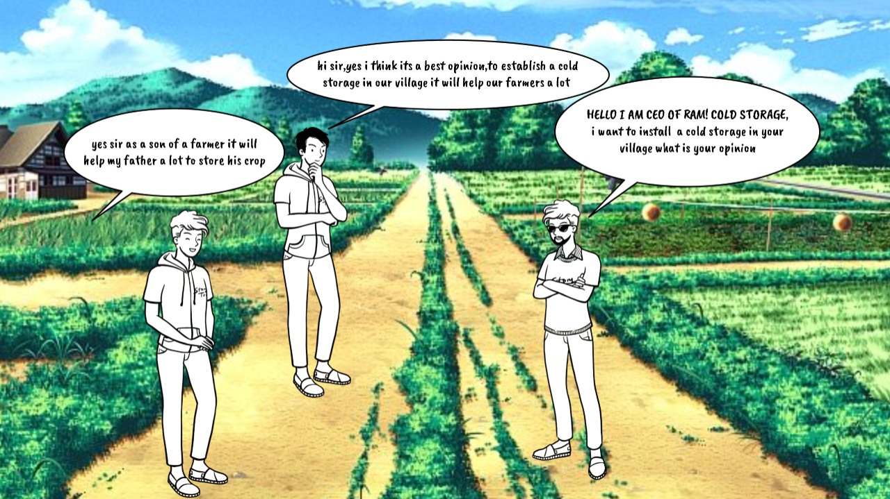
COLD STORAGE FACILITY ESTABLISHMENT

Slide 3
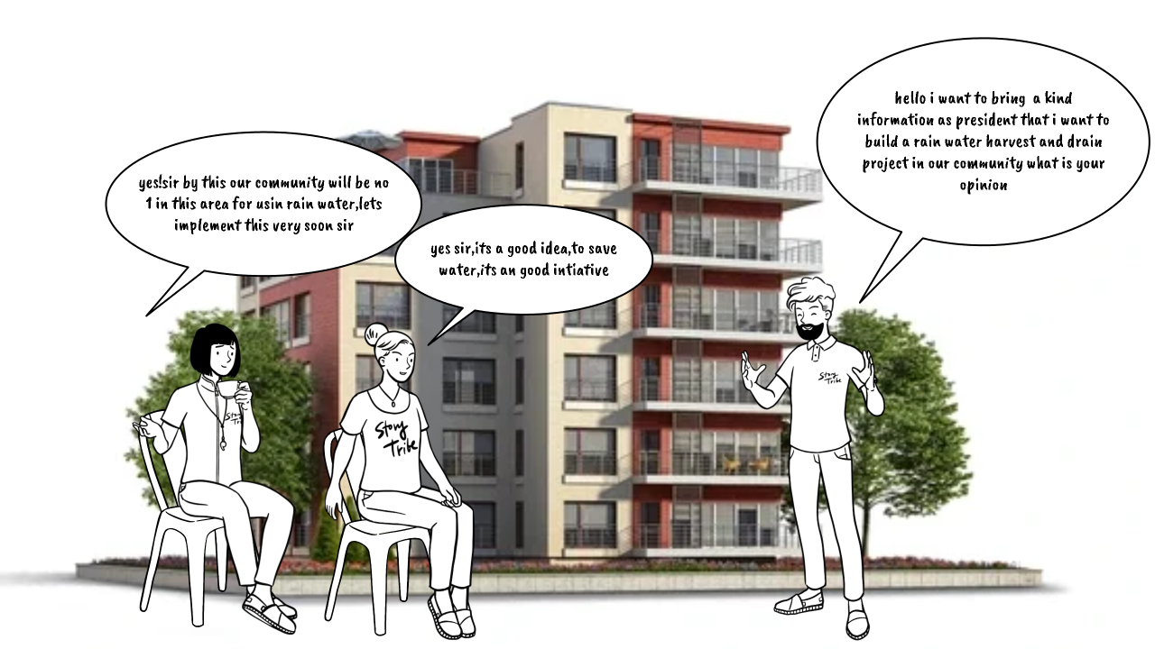
RAIN WATER HARVESTING AND DRAIN PROJECT IN COMMUNITY APARTMET

Slide 4
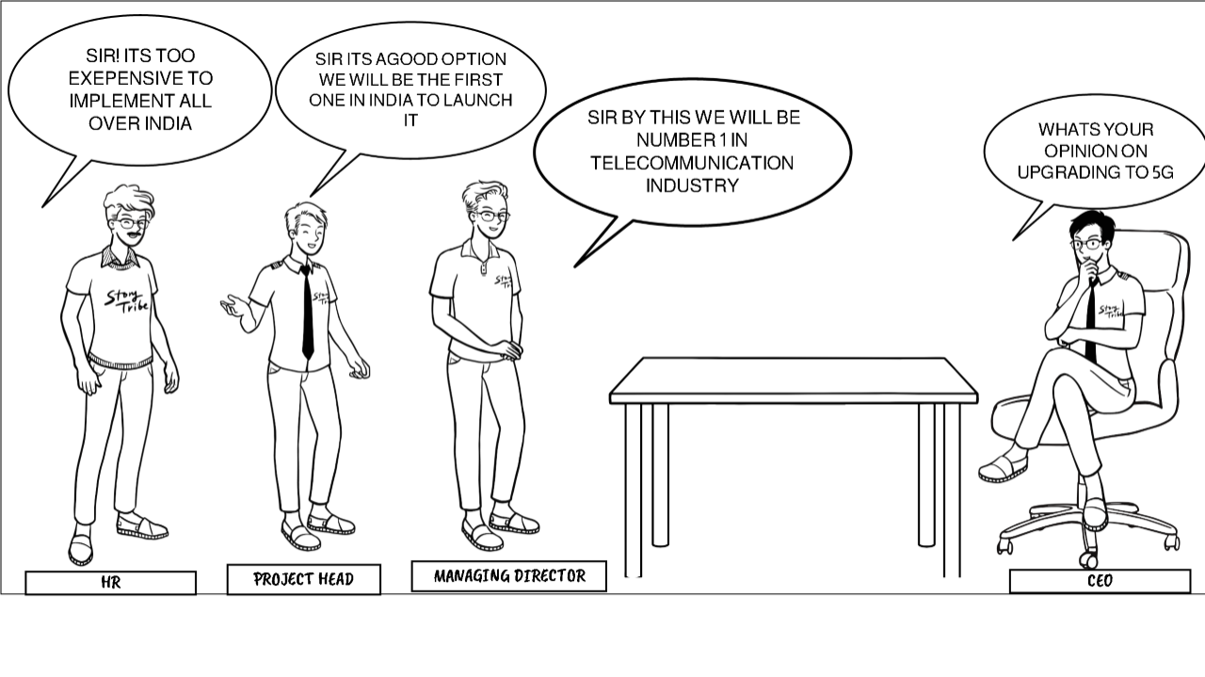
MOBILE PHONES OF A COMPANY TO BE UPGRADED WITH 5G

Slide 5
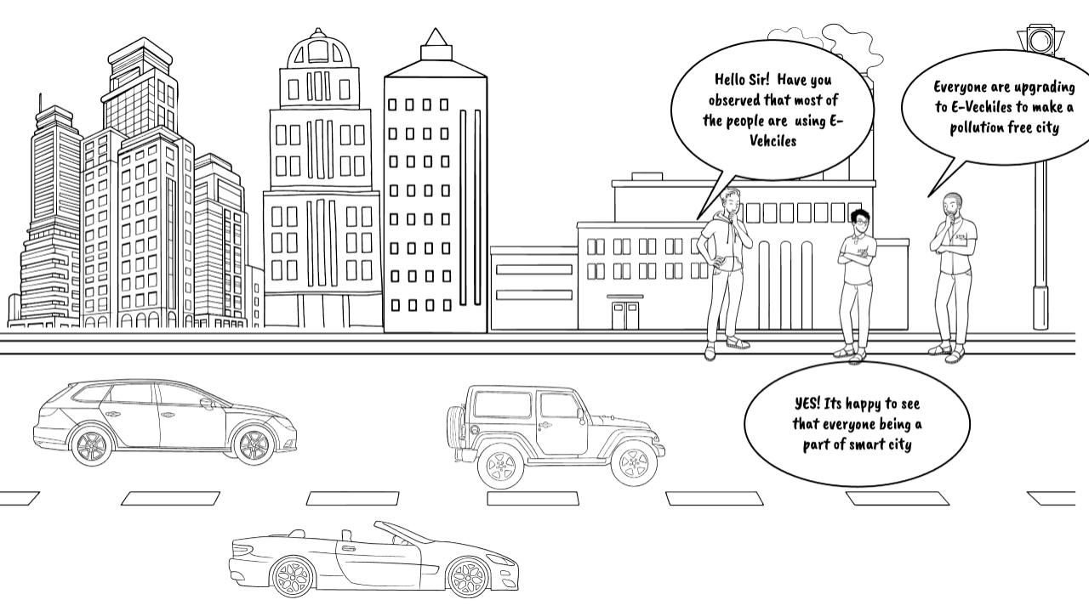
SMART CITY WITH ALL VEHICLES AS E-VEHICLES

Slide 6
TEAM DRAGON
24CS002998-BANDYALA MANISH REDDY.
24CS003048-E. SAI THEJA
24CS003032-SHIVA MANI RAO.
24CS003020-T.SIVARAMAKRISHA.
24CS002999-ABHIRAM.

